Slide 1
Maori Haka
Mohammed.I, Osman.H, Tariq.Y

Slide 2
The Maori Haka Dance
https://www.youtube.com/watch?v=BI851yJUQQw

Slide 3
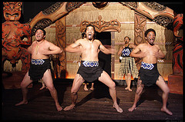
When was it made?
The Maori Haka dance has its origins in Maori legend. The exact date of when it originated is unknown
Haka is a traditional ancestral war cry,dance, or challenge from the Māori people of New Zealand.

Slide 4
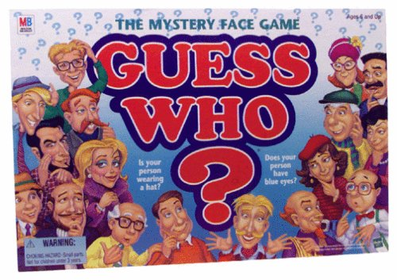
Who is represented in the expression?

Slide 5
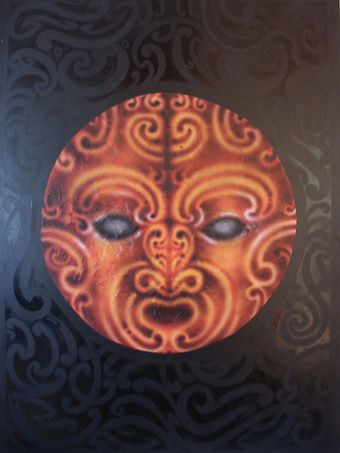
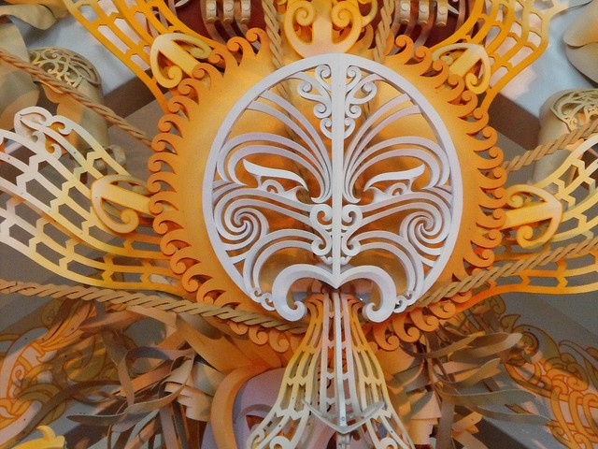
Who is represented in the expression?
The sun god Tama-nui-te-ra and one of his wives, Hine-raumati, who symbolizes the season of summer, had a son named Tane-rore.
The Maori consider the quivering appearance of the air on hot summer days to be a sign of Tane-rore dancing for his mother
The performers’ trembling hands, in a haka dance, particularly represent Tane-rore’s dance.

Slide 6
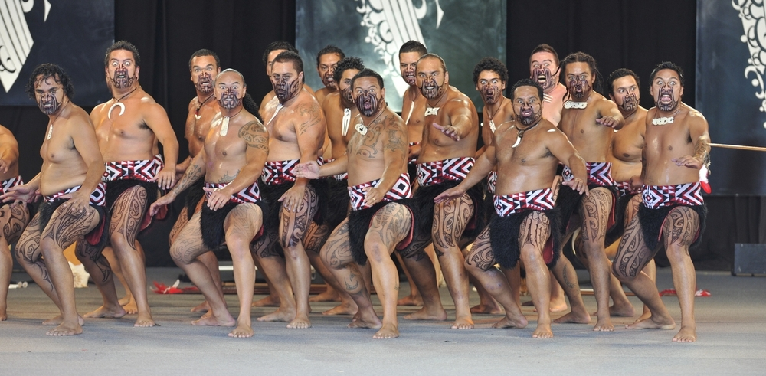
Continued...
Though often associated with the traditional battle preparations of male warriors, haka may be performed by both men and women.
Since 1972 the performance of haka, it has been one of the hallmarks of the widely popular Te Matatini performing arts festival, held every two years in New Zealand.

Slide 7
Who is not represented in the expression?

Slide 8
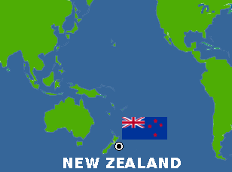
Who is not represented in the expression?
The Haka was only practiced by the maori tribe of New Zealand up until 1906 when the country’s rugby team the All Blacks introduced it to the rest of the country when first performing a version called Ka Mate haka before a game
The Maori Haka is now celebrated throughout all of New Zealand but other than that there is not much connection to the rest of the world.

Slide 9
What is the message of the expression?

Slide 10
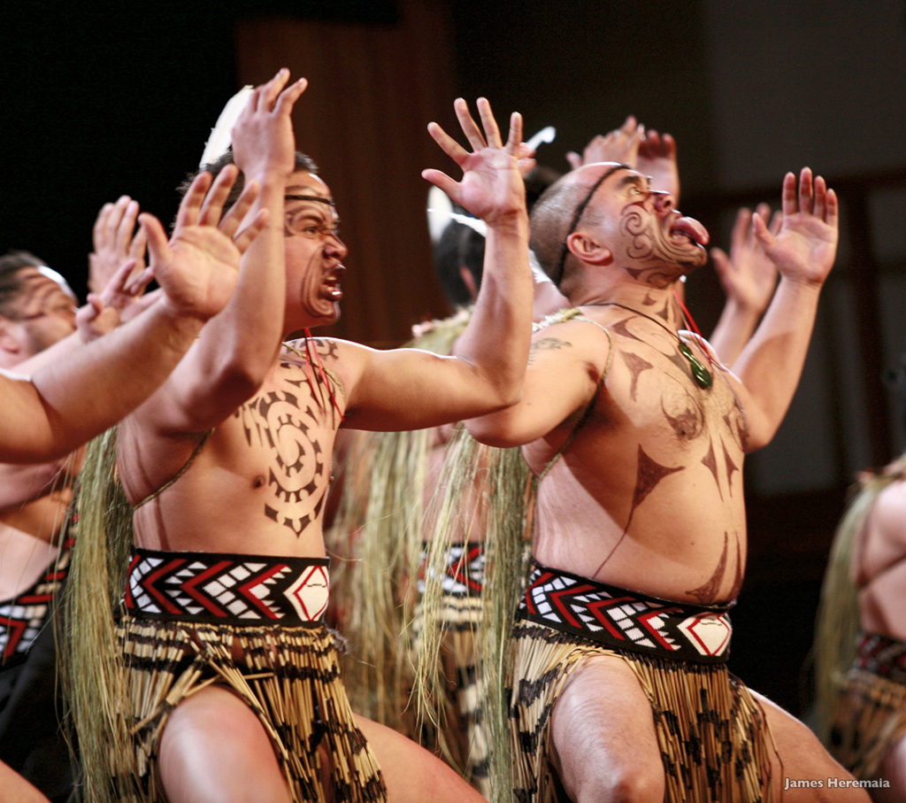
What is the message of the expression?
Haka are a fierce display of a tribe’s pride, strength and unity.
Actions include violent foot-stamping, tongue protrusions and rhythmic body slapping to accompany a loud chant.
These actions are emphasized on, to try and make the performers look intimidating and strong

Slide 11
What is the function of the expression?

Slide 12
What is the function of the expression?
Originally a haka was performed as part of the rituals of encounter when two parties met or when a visitor was welcomed into the community.
It was a custom of high social importance in the welcoming and entertainment of visitors. Tribal reputation rose and fell on the villagers ability to perform the haka
It also functioned as a battle preparation to rejuvenate Maori combatants and get them ready

Slide 13
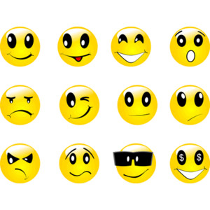
Is it connected to other forms of expression?

Slide 14
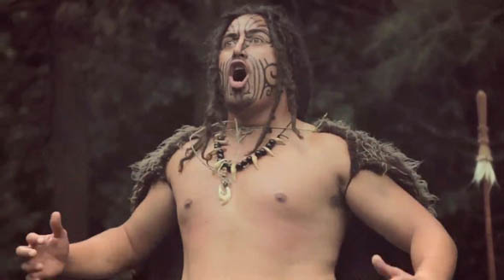
Is it connected to other forms of expression?
The haka dance is also related to the Maori people expression of music. Originally Maori people only used aerophones and idiophones, and these instruments are often used in the performances of haka dances today.
Also along with the dance facial expressions are an important facet of Māori performance. They help emphasise a point in a song or haka, and demonstrate the performer’s ferocity or passion.

Slide 15
The Maori Haka is an art which expresses both the Maori and modern New Zealand culture

Slide 16
·
How has the art functioned as a response to other elements of a culture?
The Maori Haka is integrated into many elements of the modern day culture in New Zealand
Modern examples of occasions for haka include birthdays, weddings, funerals, and other celebratory events.

Slide 17
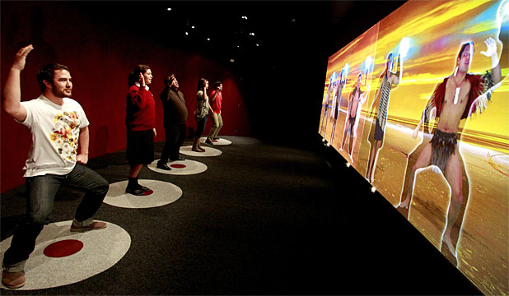
·
What is the form and function of the cultural expression in the culture?
The form of the cultural expression is a dance and in the past its function was done to scare their opponents; the warriors would use aggressive facial expressions such as bulging eyes and poking of their tongues.
Today the function of the Haka dance is to show unity and it has become a way for communities to come together and symbolize strength.

Slide 18
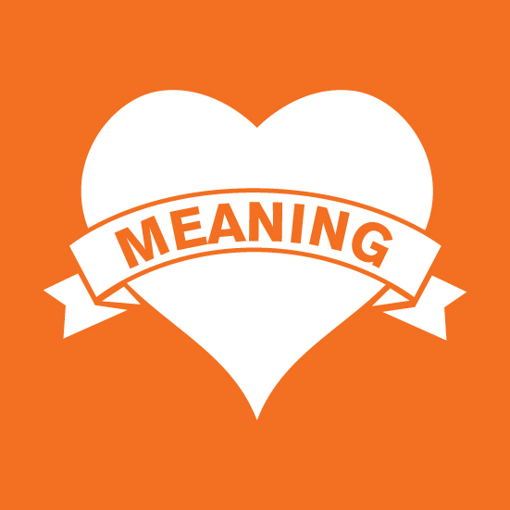
What meaning is being conveyed in the expression?
The meaning the morai tried to portray during their haka dances was that it was meant to boost their own morale
Today the Maori Haka is meant to move the performers and viewers psychologically, rather than to cause fear.
This different goal is reflected in the way that they are performed. Their movements are more free, giving each participant the freedom to express themselves in their own movements.

Slide 19
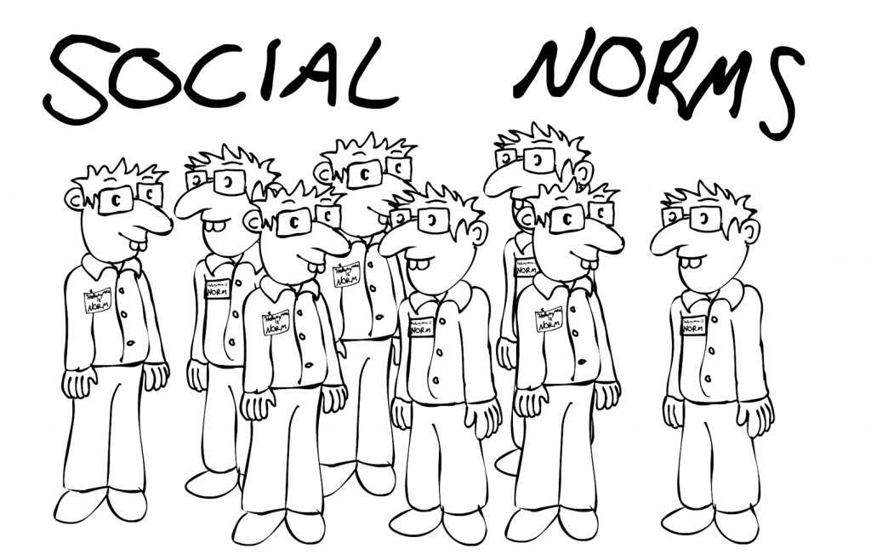
How does the art express the norms, values and philosophy of the culture?
The art expresses norms such as competition as it was used during war preparations in the past and today is used in rugby game preparations.
It also expresses values and philosophies such as pride, strength and unity

Slide 20
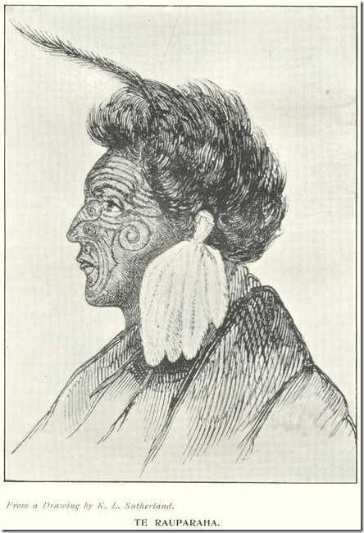
What is the influence of various social, economic, or political conditions or events on the art?
War was a huge influence in the making of the maori haka as it paved the way for the maori’s to express themselves in a dominant way while showing off their strength
One particular event that influenced the art of the haka was when Te Rauparaha created the haka after he narrowly escaped death at the hands of enemy tribes from Ngāti Maniapoto and Waikato by hiding in a dark food storage pit.

Slide 21
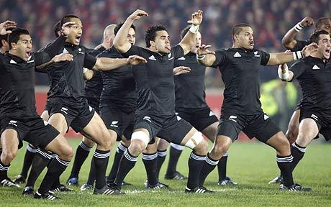
What is the influence of various social, economic, or political conditions or events on the art?
When he came out of the pit, he was greeted by light and a friendly tribe chief. The famous first line, “Ka mate, ka mate! ka ora! ka ora!” Translates into “I might die! I might die! I may live! I may live!”
This line is apart of a version of Haka which he created called the Ka Mate Haka
Ka Mate Haka is very famous considering New Zealand’s international rugby team performs it before every game

Slide 22
All Blacks perform Ka Mate Haka
https://www.youtube.com/watch?v=tdMCAV6Yd0Y

