Slide 1
What is Language?
By: Prabjot, Sajida, Davette, Molly and Amy

Slide 2
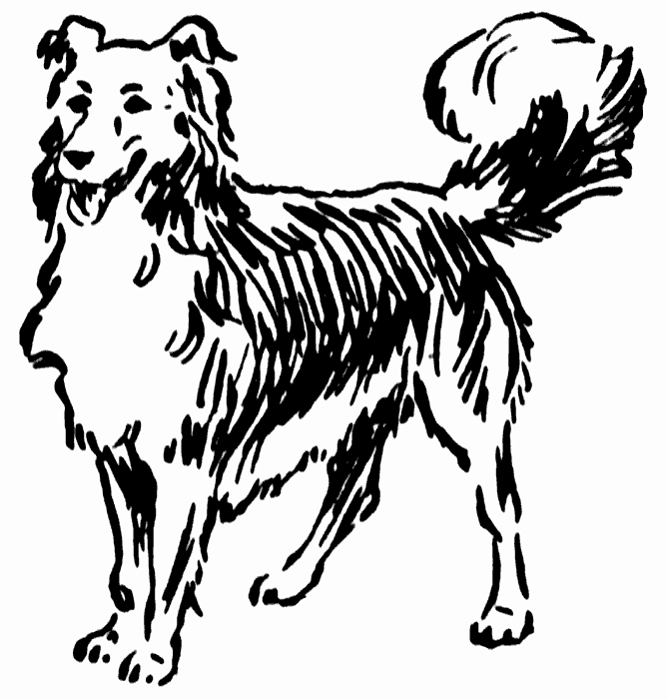
Introduction
Language is a set of rules for generating speech
Language is learned instead of being biologically inherited
Symbols are sounds or things which have meaning given to them by the users
Meaning is arbitrarily assigned
For instance, the English word “dog” does not in any way physically resemble the animal it stands for

Slide 3
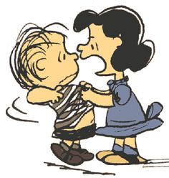
Symbolic Meaning
A word is one or more sounds that in combination have a specific meaning assigned by a language
Major advantage of human language being learned symbolic communication is that its infinitely flexible, meanings can be changed and new symbols created
Evidence: new words are invented daily and the meaning of old ones change
For example, the english word “nice” now means pleasing, agreeable, polite, and kind
In the fifteenth century it meant foolish, wanton, lascivious, and even wicked

Slide 4
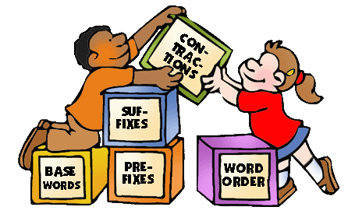
Language vs. Speech
Language and speech are not the same thing
Speech is a broad term simply referring to patterned verbal behaviour
A dialect is a variant of a language. If it is associated with a geographically isolated speech community, it is referred to as a regional dialect.
However, if it is spoken by a speech community that is merely socially isolated, it is called a social dialect
These latter dialects are mostly based on class, ethnicity, gender, age, and particular social situations
Black English (or Ebonics) in the United States is an example of a social dialect

Slide 5
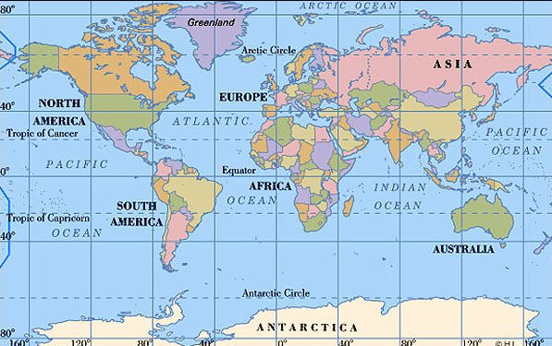
Pidgin
Pidgin is a simplified, makeshift that develops to fulfill the communication needs of people who have no language in common but who need to occasionally interact for commercial and other reasons
combine limited amount of the vocabulary and grammar of the different languages
also speak native language
Most well known, Pidgin English in New Guinea
Pidgin English/French developed in West Africa and Caribbean
Most well known pidgin developed by American Indians is Chinook

Slide 6
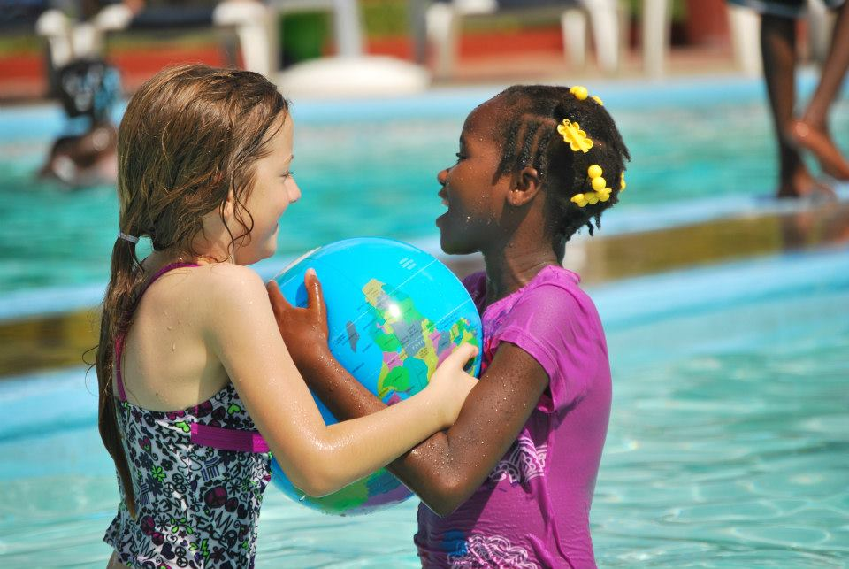
Creole
Creole:
A pidgin language that becomes the mother tongue of a population.
In other terms, a simplified version of a language. Ex. Haitians’ creole language is French-African.
Pidgins form into creoles as vocabulary enlarges
Fun Fact: Most Creole languages make use of repeated adjectives or adverbs, used to indicate an increased degree of intensity.

Slide 7
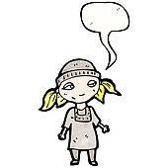
Language & Social Situations
Which language is spoken can sometimes depend on the social situation. This phenomenon is called diglossia which refers to a situation in which two dialects or usually closely related languages are used by a single language community
North American reporters are often diglossic, they must learn to speak with a Midwestern, European American dialect regardless of the region or social class they are from originally
The dialects of a society are ranked to each other in terms of social status
In the London area of England the upper class speak “public school” English while the lower class use a different dialect.

Slide 8
Conclusion
Language is an essential way to communicate
differentiates one country/region or culture from one another
Languages are made up of patterns of sounds and repetition.

