Slide 1
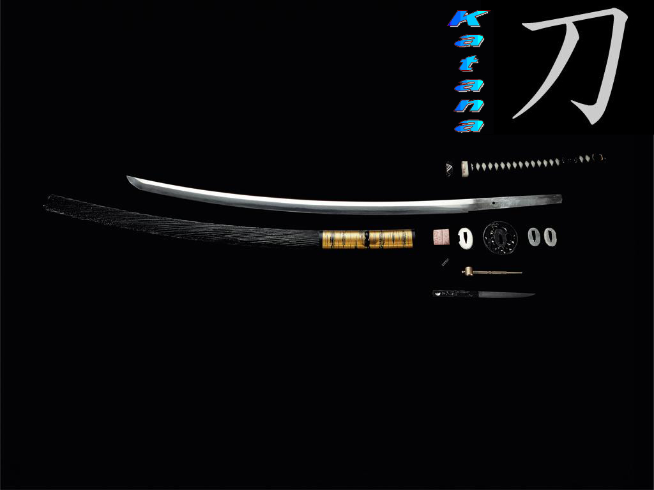
The Illustrious Samurai
Mohamed Abdullahi
Ibrahim Saleh
Adrian Nazir

Slide 2
Table of Contents
PG 1: Intro
PG 2: The Katana Blade
PG 3: The Purpose (Expression of the Blade)
PG 4: Who’s Not Expressed
PG 5: How The Katana Functions In Society
PG 6: The Meaning Conveyed
PG 7: Reference

Slide 3
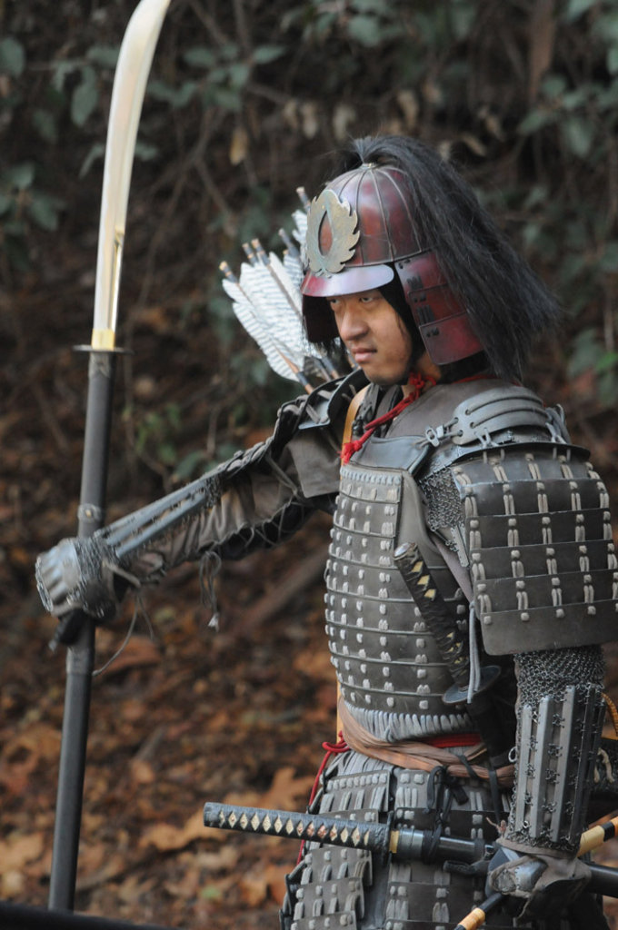
Intro – Speaker Ibrahim
“戦士の道が美しいです”
“The way of the warrior is beautiful”
The Samurai were a group of warriors who protected their Daimyo (Lords) and used Bushido (Honor Code) as their nindo (One’s way of life).
The Samurai while warriors, used art and expression in their everyday lives. While not as obvious as to others, was part of everyday life for them.

Slide 4
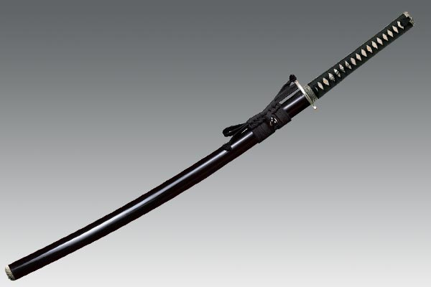
The Katana Blade – Speaker Adrian
Of course Samurai and Japan itself has many great works of visual arts, music, dance, drama, literature & architecture, but the katana is the ultimate art for a Samurai. The blade is not only a weapon but a Samurai’s pride and greatest companion for life. They were first created in the Muromachi period (1392 to 1573) to present.

Slide 5
The Purpose (Expression of the Blade) – Speaker Mohamed
The Katana blade had multiple uses,
Warfare
Status
Familial History
Warfare – Used in times of war and fighting.
Status – Signified your position and class.
Familial History – Katana blades were passed down from generation to generation.

Slide 6
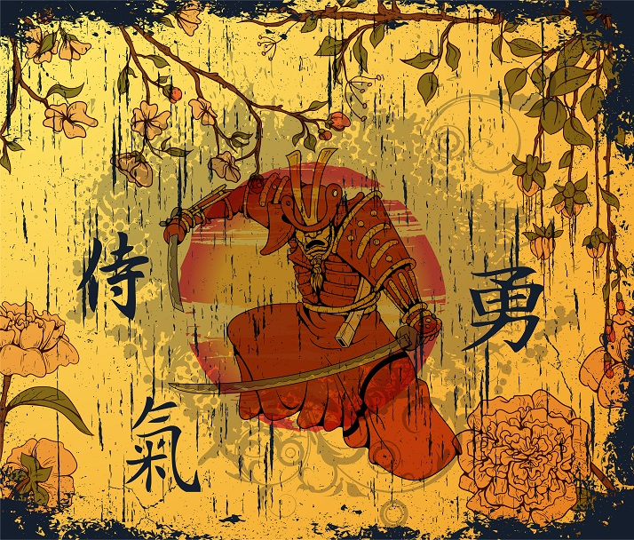
Who’s Not Expressed – Speaker Ibrahim
A katana could only be used by the Warrior noble class of the Samurai, as such the poor or middle class weren’t expressed in the making of katanas.

Slide 7
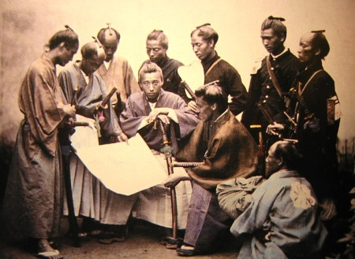
How The Katana Functions in Society - Speaker Adrian
The Katana exemplifies Ancient Japan’s fighting spirit and was a symbol referenced with the country. It is a sign of power and social standing for a Samurai signifying class and responsibility.

Slide 8
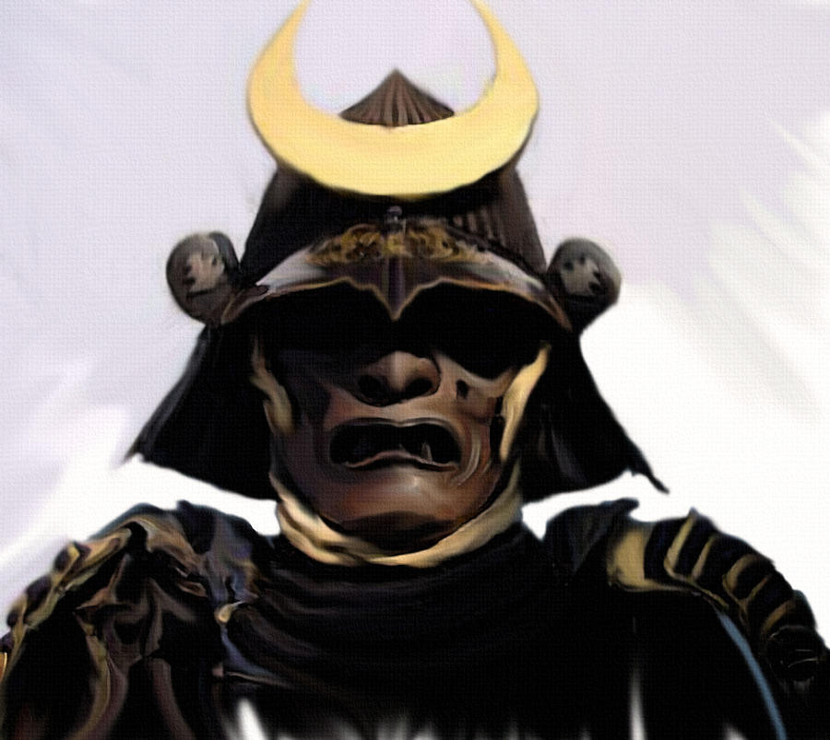
The Meaning Conveyed – Speaker Mohamed
The Samurai’s katanas along with their menacing suits of armor and meticulously crafted sword blades are evidence of the samurai's military might, while exquisitely painted scenes of nature and finely crafted tea ceremony objects reveal their aesthetic ideals.

Slide 9
References
False Idols: Martial Artists and Samurai Iconography | FIGHTLAND. (n.d.). Retrieved February 27, 2015, from http://fightland.vice.com/blog/false-idols-martial-artists-and-samurai-iconography

