Slide 1
Genocide In Rwanda
Case Study

Slide 2
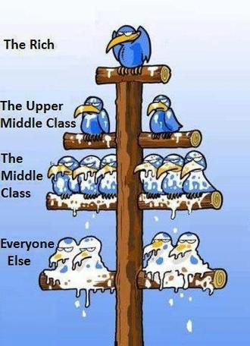
Social stratification in review
Social stratification is a system whereby some members of a society are ranked higher or lower relative to other members.

Slide 3
What is genocide?
The deliberate killing of a large group of people, especially those of a particular ethnic group or nation.
Example: the holocaust: the Nazi government’s attempt to exterminate Europe’s Jewish population

Slide 4
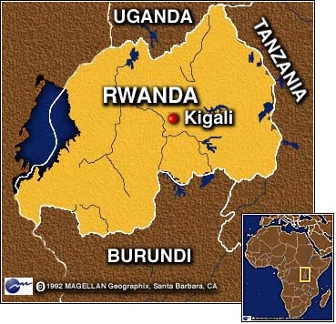
Rwanda: Where are you?
Located a few degrees south of the Equator, Rwanda is bordered by Uganda, Tanzania, Burundi and the Democratic Republic of the Congo.

Slide 5
Rwanda: Who are you?
1994: Rwanda had a population of 7 million and composed of three ethnic groups:
Hutu 94%
Tutsi 14%
Twa 1%

Slide 6
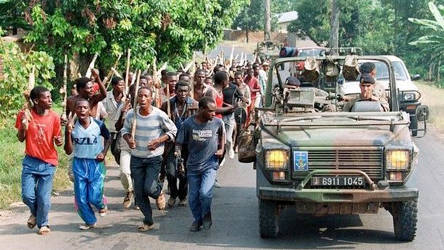
Rwanda: Issues
Hutu extremists within Rwanda’s political elite blamed the entire Tutsi minority for the country’s increasing social, economic, and political pressures. Tutsi civilians were also accused of supporting a Tutsi-dominated rebel group RPF (Rwanda Patriotic Front).
https://www.youtube.com/watch?v=fcC8NCk82WA

