Slide 1
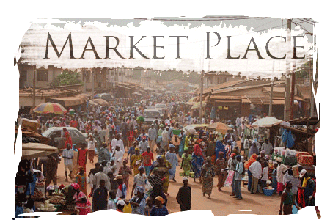
CH. 6 – Economic Systems

Slide 2
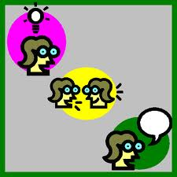
What do you know about economic systems?
THINK – PAIR – SHARE
Grab a piece of paper and ask yourself:
What do I know about economic systems?
What examples can I think of?
Share your ideas with a friend

Slide 3
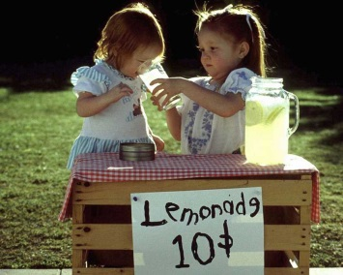
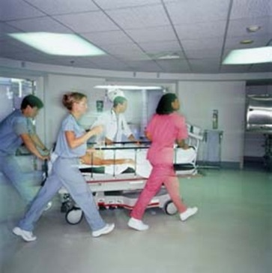
Examples of economic systems
STUDY
THIS
1. Individuals own the goods and services they produce. The goal is to maximize consumption in order to maximize profits of the owners.
2. Production and distribution of goods and services are shared by a group of people. There is no individual ownership. The goal is to meet everyone’s consumption needs equally.

Slide 4
An Economic System Is…
STUDY
THIS
Economic System: Regulation of production, distribution, and consumption of goods
There are three major types of economic systems:
1. Consumption (i.e. Capitalism)
2. Redistribution (i.e. Socialism)
3. Exchange (i.e. bartering, gift giving)
Western views of economics neglects systems of exchange, even though they exist.
Unlike western societies, some groups are present-oriented, survival-centered societies (ex. hunting-and-gathering First Nations), meaning that they only worry about the needs of today. When immediate needs are met, production and distribution stops.
In order to understand the pattern of supply and demand, culture must be considered.

Slide 5
What is Reciprocity?
STUDY
THIS
With a friend, write down everything you think reciprocity means
Western economics focuses mainly on virtual markets, and the exchange of money.
But in fact, there are many cultures without money that still exchange goods and services.
Reciprocity: A “physical” exchange of goods and services of approximately equal value between two parties.
Ex. Throwing a Party – you put one on with the expectation that you will be invited over sometime. Reinforces community bonds, kind of I.O.U.
A levelling mechanism (punishment, banishment, etc.) is used with reciprocity to promote egalitarian distribution of wealth over the long run

Slide 6
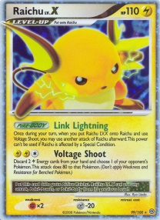
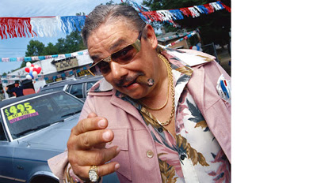
What is Reciprocity?
STUDY
THIS
Generalized reciprocity (Gift economy): a form of exchange in which the value of the gift is not calculated, nor is the time or repayment specified.
“IT’S ON ME! MY TREAT! I GOT YOU!”
Ex. Gifts, Good Samaritan, Pay it Forward
Balanced reciprocity (Barter economy): a form of exchange whereby the giving and the receiving are specific in terms of the value of the goods and the time of their delivery (not long term)
Ex. Trading cards, taking turns buying drinks
Ex. A women talented in tanning buffalo hides, her and her helpers are fed, she receives land
Negative reciprocity (Bargain/Haggle economy) : a form of exchange whereby the giver tries to get the better of the exchange (usually during trade with outsiders)
Ex. Dishonest car salesman, the Mob in the movies

Slide 7
TABLE MAT ACTIVITY
Divide into groups of 4
Each member of the group will think of an example of reciprocity in their own life (feel free to help each other)
With different colours, write or draw your examples onto graph paper as shown below
Briefly present to the class
Example 1
Example 2
Reciprocity
In My Life
Example 3
Example 4

Slide 8
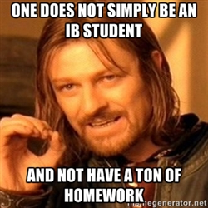
Original Study: Reciprocity on Skid Row
As a class, read “Reciprocity on Skid Row” p.166 of Cultural Anthropology
After the reading, write a reflection paragraph, answering the following questions:
What examples of reciprocity are seen on Skid Row?
How are the economic systems of Skid Row different those used by most other Canadians?
c. How has my perception of the homeless changed?
d. What would an effective social program targeting the homeless look like? (Be specific)
Hand in your reflection paragraph and have a great weekend!!

