Slide 1
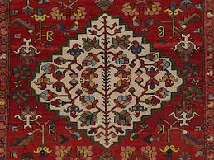
BAKHTIARI
By:Weris, Crystal, Brittany & Sahur

Slide 2
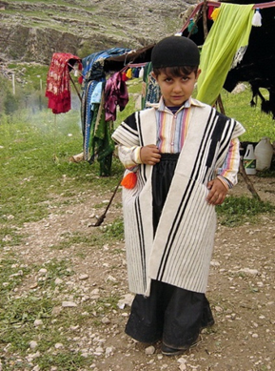
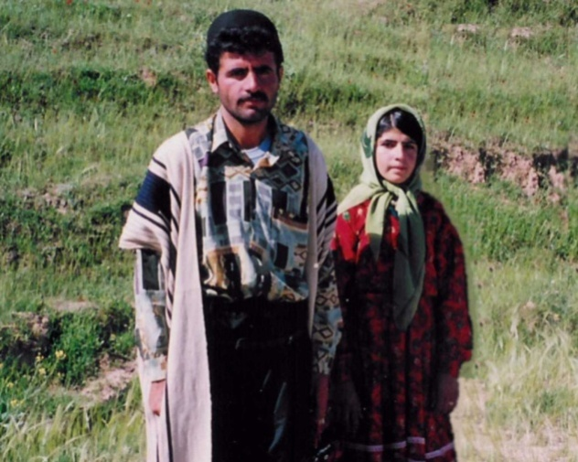
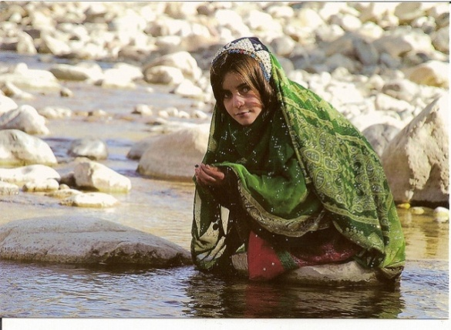
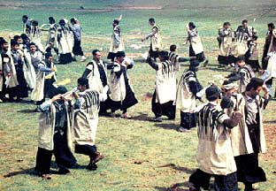
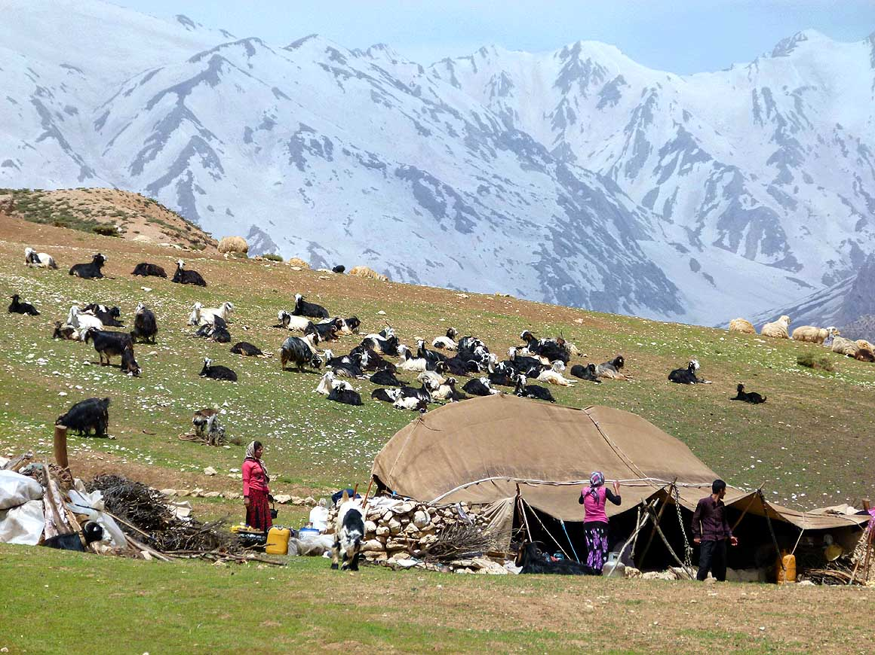
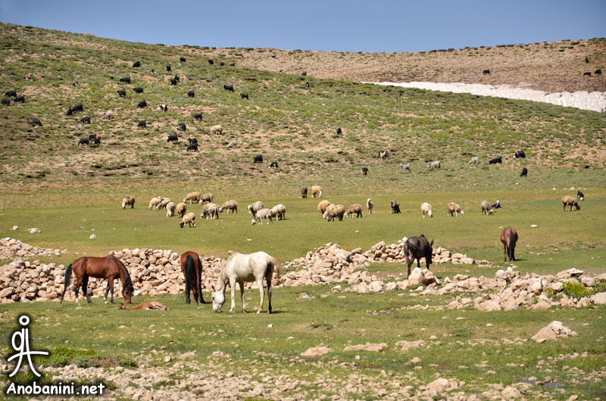
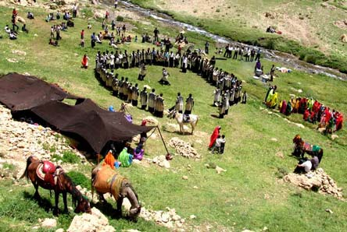
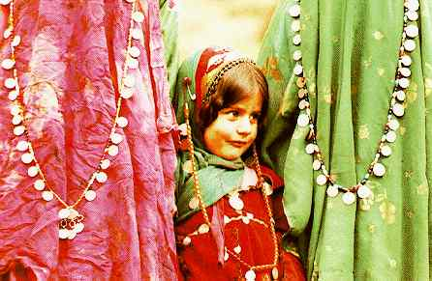
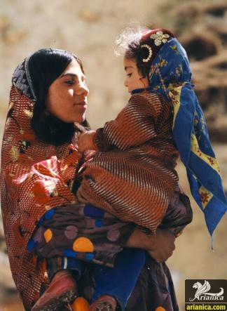
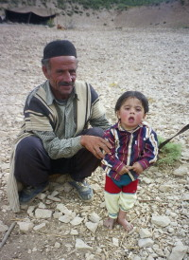
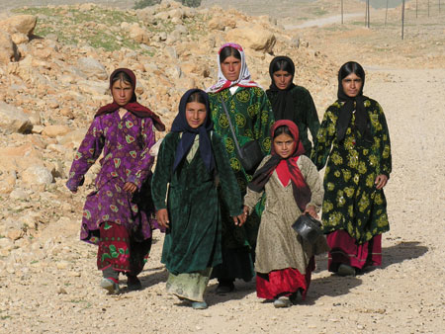
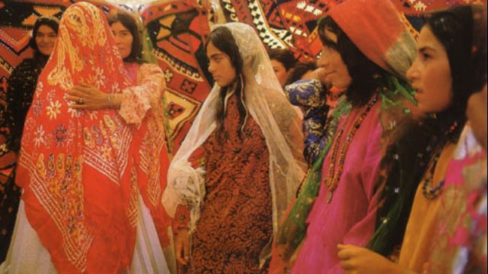
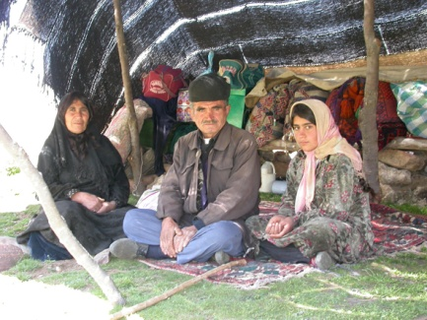
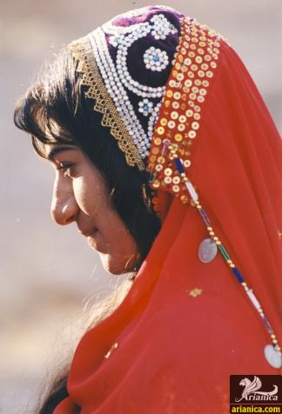
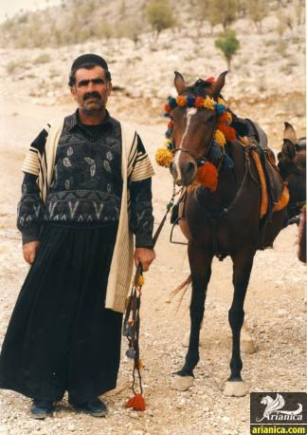
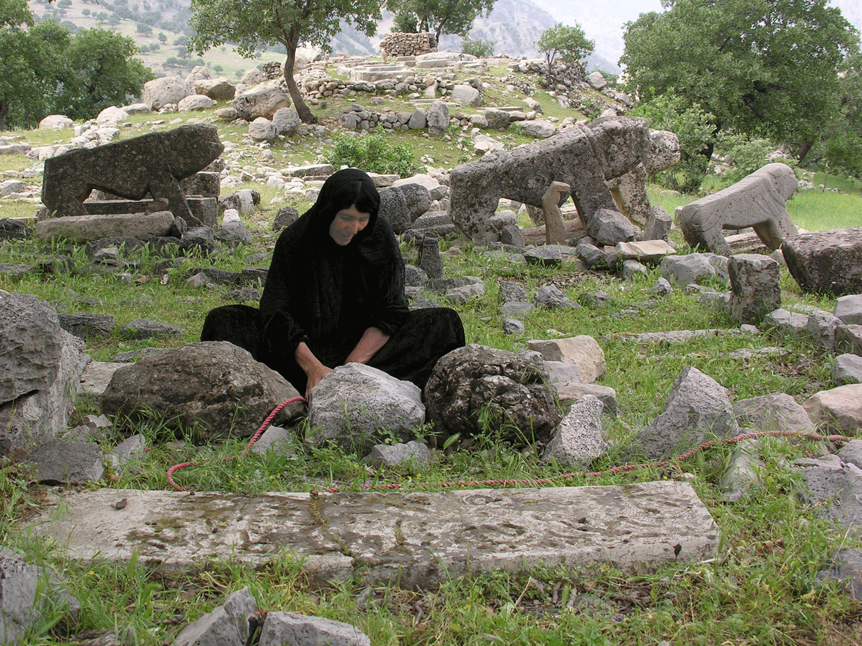

Slide 3
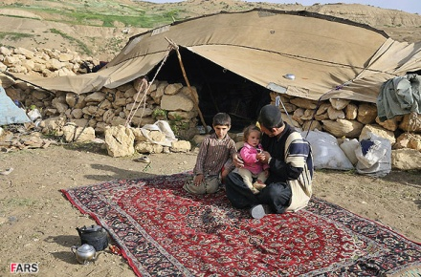
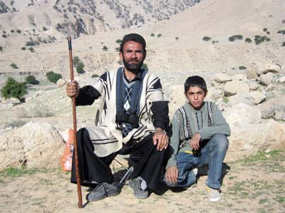
SEXUAL DIVSION OF LABOUR/CHILDREN RAISED IN FAMILY SETTING
The Bakhtiari tribe follow a traditional lifestyle as they migrate seasonally with their sheep, cattle or goats herds from highland pastures to lowlands plains.
The men's work consists of shepherding while the women do homemaking and carpet weaving.
Children are raised to help their parents with the herds and start helping around at early ages 9-10

Slide 4
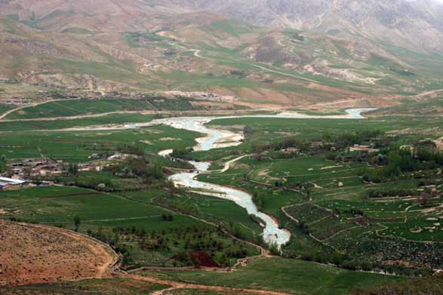
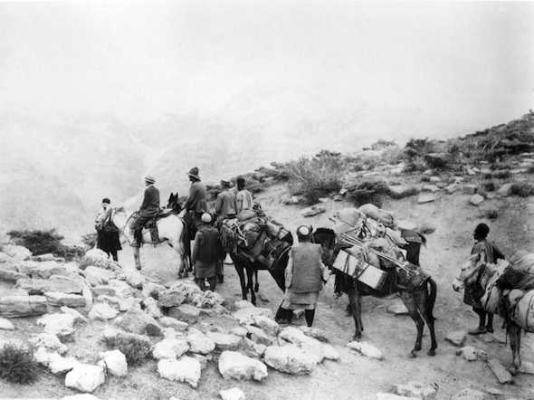
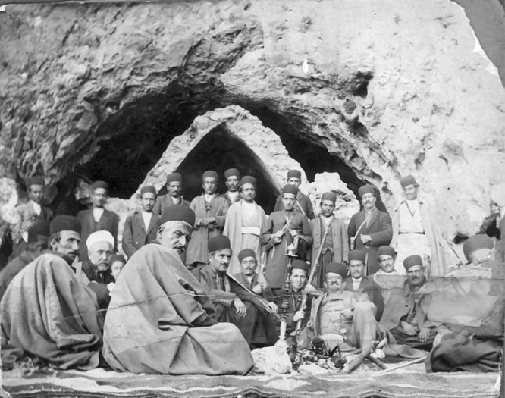
CONCEPT OF PRIVACY
Bakhtiari believe staying in within the boundaries of their lands. There would be a line of stepping stones separating lands between neighbors as it was considered customary law.

Slide 5
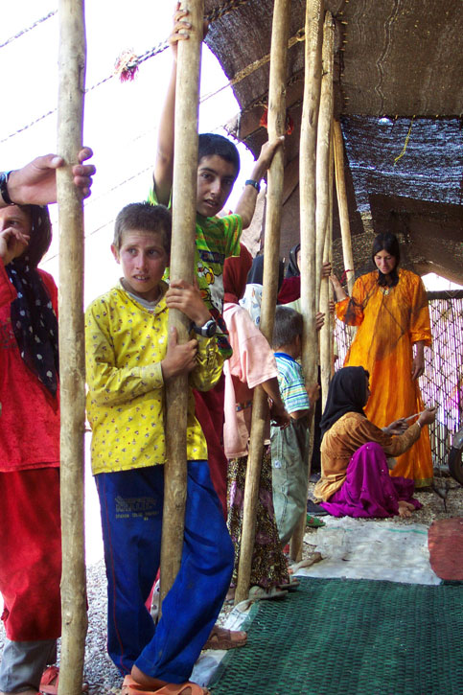
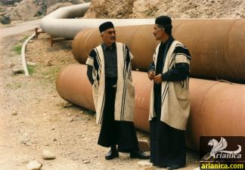
Verbal Language
Baktiari people speak Bakhtiari diaclect, a southwestern Iranian dialect, belonging to the Luri language. The Luri language is a descendant of Persian is quite similar to Modern Persian. Luri also represents a language continuum between Persian language and Kurdish language varieties, and is itself composed of three distinct languages: Loristani, Bakhtiari and Southern Luri.

Slide 6
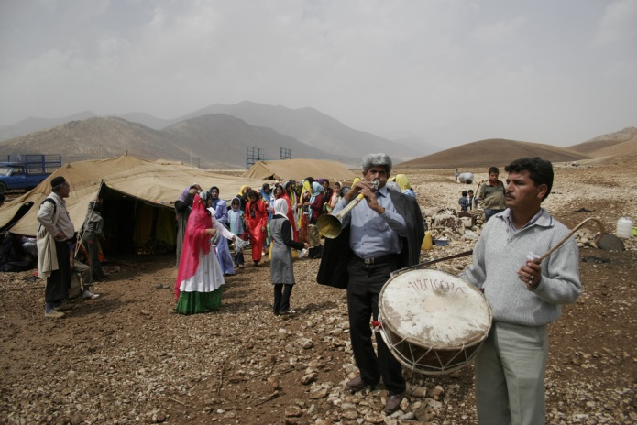
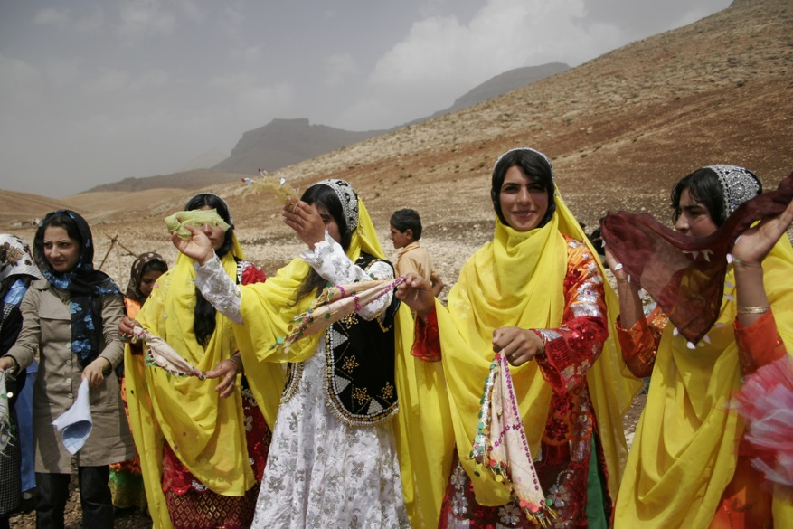
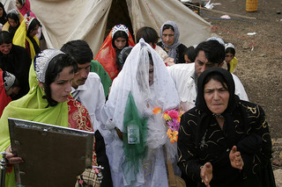
Marrriage
The Bakhtiari people are mainly from two tribal divisions, Chahar lang (English: Four Legs) and Haft lang (English: Seven Legs). Due to the harsh nature of their life style, Bakhtiaris have been able to keep their blood lines intact, largely marrying within their own tribe. Nafburoon has been a tradition among the Baktiari culture where whenever a girl and a boy are born close together in time; parents determine their children's fate.

Slide 7
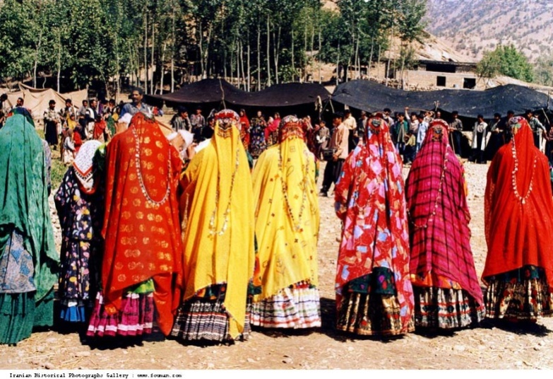
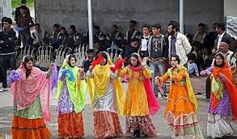
Rules that regulate sexual behavior
Religion; The Bakhtiari people are Shi’a Muslim, and in the religion of Islam premarital relations is forbidden. Meaning that sexual behavior Is restricted unless the parties are wed.
Also the Baktiari people like to marry within their subtribes. So that the child is from either the Chahar Lang tribe or the Haft Lang tribe.
When a bakhtiari women is ready to be married her family arranged the marriage and she is not allowed to protest in respect to her parents.

Slide 8
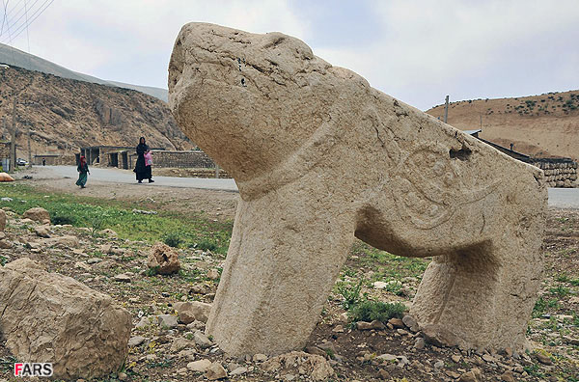
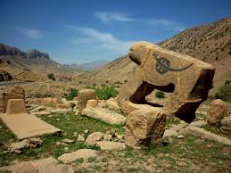
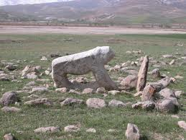
Distinguish between good and bad behavior
The Bakhtiari people believe that the lion is the most honorable and respectable of creations.
The symbol of the lion represents bravery and overall respectability in Bakhtiari culture. So when a man dies in a “brave” way (i.e protecting his family) a carved lion sculpture is placed on his grave.
But when a man dies in a “cowardly” manner (i.e Running away from his responsibilities) a stone is placed on his grave. To show that the man was a coward. The Bakhtiari frown upon men who are weak and not brave. So it is considered good behavior to be honorable and not cowardly.

Slide 9
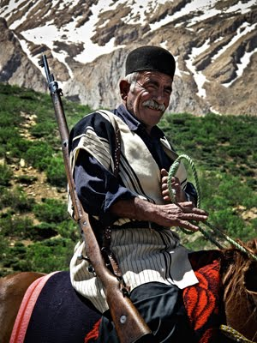
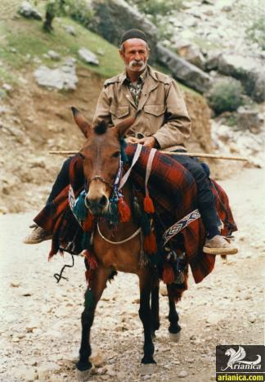
Leadership Roles
In the Bakhtiari tribe there are kalantars (Head men) Khans (clan chiefs) and ilkhani’s (chief of entire Tribe)
Power of the Khans and Ilkhanis come from their personal abilities. Abilities to lead and keep the peace within the tribe. Also the respectability of them and their family. These positions are sometimes succeeded/inherited by family of the former Khan or Ilkhani.
Every sub tribe of the Bakhtiari has a Khan that resolves issues and takes care of the problems within his jurisdiction.

Slide 10
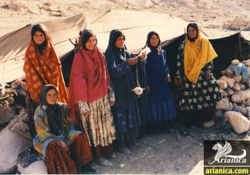
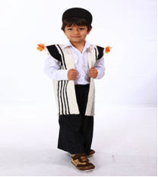
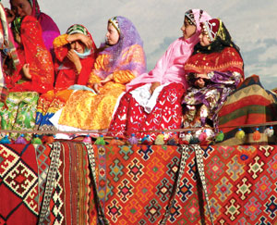
Body Ornamentation
Bakhtiari clothing are said to be so guarded that they protect the people from really high weather conditions. The people of Bakhtiari don’t wear shoes because they think shoes belong to the people who live in the city.
The men wear a tunic over their roomy trousers and the trousers stay put around their ankles with wide embroidered bands, a leather belt, a large sash or a rolled cloth.
The women wear long, colorful full skirts which they top off with a thin-brighter-colored material. The skirts are matched up with non-matching shirts, matching vests or shawls

Slide 11
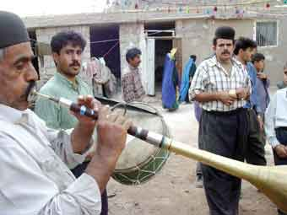
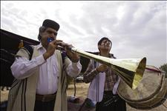
Art
Music is one of the most important parts of long established folk culure because it shows the worth and personalities of people. Bakhtiari music is surrounded by the wealthiest and largest choices of Persian maqam music. Maqam means melody or tune and it suggests a musical document which could include in another language, instruments and usually differs from one melody to another melody.

Slide 12
Citations
KrePublishers.com . Retrieved Sept 22. 2014 .http://www.krepublishers.com/02-Journals/T%20&%20T/T%20&%20T-10-0-000-12-Web/T%20&%20T-10-01-000-12-Abst-PDF/S-T&T-10-1-029-12-258-Shahbazi-M-R/S-T&T-10-1-029-12-258-Shahbazi-M-R-Tt.pdf
Bakhtiari Facts, information, pictures | Encyclopedia.com articles about Bakhtiari. (n.d.). Retrieved from http://www.encylopedia.com/Topic/Bakhtiari.aspx
Lions’ Representation in Bakhtiari Oral Tradition and Funerary Material Culture | Pedram Khosronejad - Academia.edu. (n.d.). Retrieved from http://www.academia.edu/1624978/Lions_Representation_in_Bakhtiari_Oral_Tradition_and_Funerary_Material_Culture Iran's Muslim Bakhtiari People (Loving Muslims Through Prayer www30daysnet)
http://www.30-days.net/muslims/muslims-in/mid-near-east/iran-bakhtiari-people/
SOAS, University of London (The School of Oriental and African Studies) (Brunei Gallery at SOAS: Bakhtiari Kuch:Tribal Life: Tribal Women On Migration)
http://www.soas.ac.uk/gallery/bakhtiari-kuch/tribal-life/migration/women/

Slide 13
Citations Continued
Home (The Bakhtiari nomads)
http://www.voiceofchristmedia.org/38-impact-news/102-the-bakhtiari-nomads
Bakhtiari (Bakhtiari)
http://www.ancientworlds.net/aw/Places/District/813573
Drynet: Initiatives. (n.d.). Retrieved from http://www.dry-net.org/index.php?page=3&successstoryId=6 Encyclopedia of National Dress: Traditional Clothing Around the World [2 ... - Google Books. (n.d.). Retrieved fromhttp://books.google.ca/books?id=lazWAQAAQBAJ&pg=PA346&lpg=PA346&dq=bakhtiari+clothes&source=bl&ots=rHqNvD06SC&sig=hv7K_X7fjnEWdQd5aW6Dvr0coh4&hl=en&sa=X&ei=Gn8gVJObJsyeyATMtoDQBA&ved=0CGQQ6AEwDg#v=onepage&q=bakhtiari%20clothes&f=false irandokht - Mind & Body. (n.d.). Retrieved from http://www.irandokht.com/editorial/print.php?area=per§ionID=3&editorialID=1007 CLOTHING xxv. Clothing of Lori-speaking tribes – Encyclopaedia Iranica. (n.d.). Retrieved fromhttp://www.iranicaonline.org/articles/clothing-xxv Music of Bakhtiari. (n.d.). Retrieved from http://www.farhangsara.com/bakhtiari_music.htm The traditions and customs of the Bakhtiari are reflected in the names of their magham. | Mehdi Hosseini. (n.d.). Retrieved fromhttp://www.monodies.com/bakhtiari/

